Slide 1
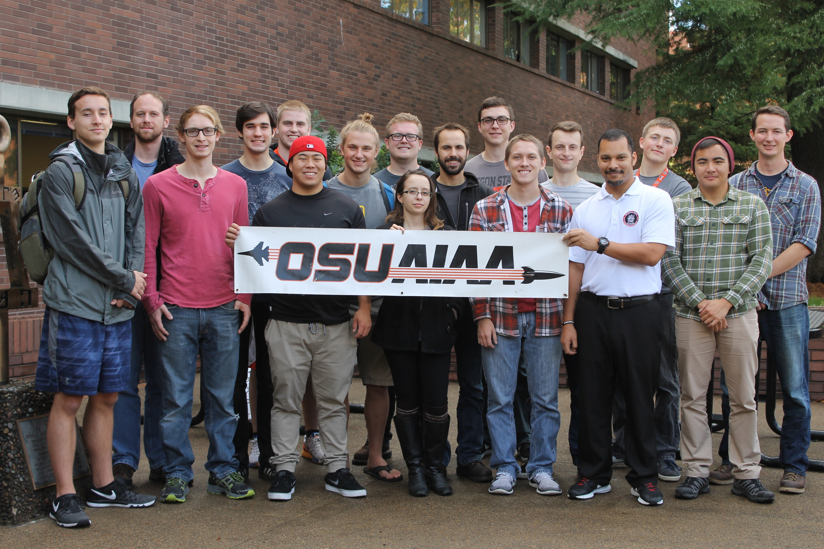
Fall Progress Report
Team #25
Natasha Anisimova, Terrance Lee, Albert Morgan

Slide 2

Introduction: The Problem
Launch a rocket in the Black Rock Desert
Receive telemetry and visualize in real-time
Aid in recovery
Track rocket
Log telemetry for later retrieval
Create a usable user interface

Slide 3
Our Clients
High-Altitude Rocketry Team
Led by Dr. Nancy Squires
Clients are engineering students
Software team given a lot of flexibility

Slide 4
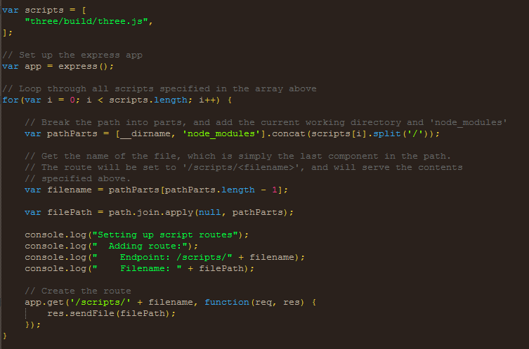
Automatic script routing

Slide 5
Architecture
Client
Web Server
Client
New Packet from Rocket
New Packet
Event
Client
Logger
Other processes

Slide 6
Built-in Node Web Server
Easier to install
Easier to run
Easier to develop

Slide 7
Logging: CSV Instead of JSON
{
{
“item 1”: “value1”,
“item 2”: “value2”
},
{
“item 1”: “value1”,
“item 2”: “value2”
}
} ← This curly brace is missing!

Slide 8
Retrieval
Protocol
Separate Data retrieval between the two stages
Multiple Disciple
March Test

Slide 9
Demonstration
<Live demonstration video goes here>

Slide 10
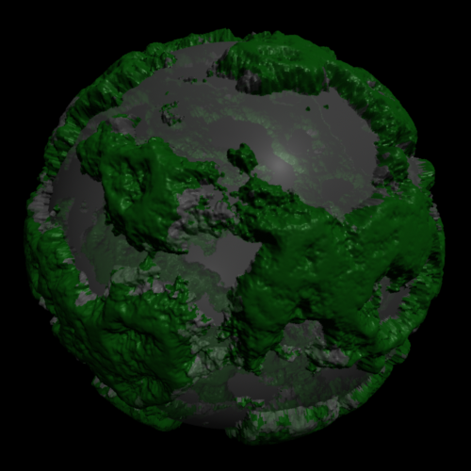
Frontend and Web Browser
Tables updating in Real-Time
3.js
WebGL canvas
Displacement mapping
GPS only turns on at apogee

Slide 11
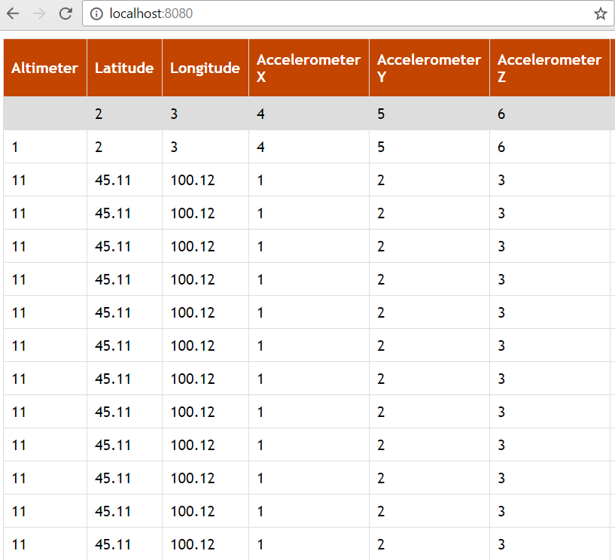
User Interface
Numerical Data
Data Visualization
Height Map for Spaceport America
Mike Bailey
Scale aspect ratio
Web dependencies

Slide 12
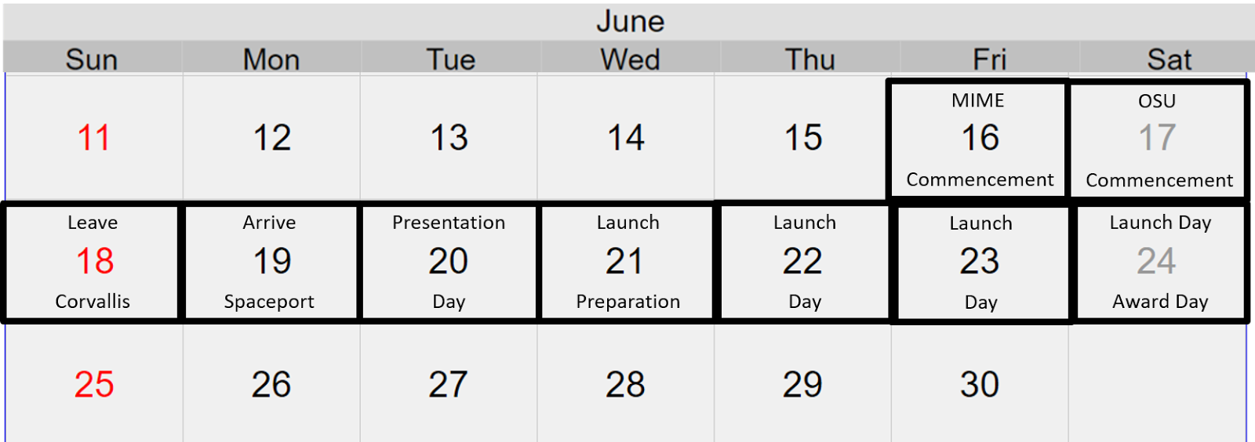
Retrospective of the past 6 weeks
Working with OSU AIAA Chapter Team (High-Altitude Rocketry Team)
Setup Communication Protocol
Revision of Documents
Launch Travel Plans
Issues
Branching
GPS turning on at apogee

Slide 13
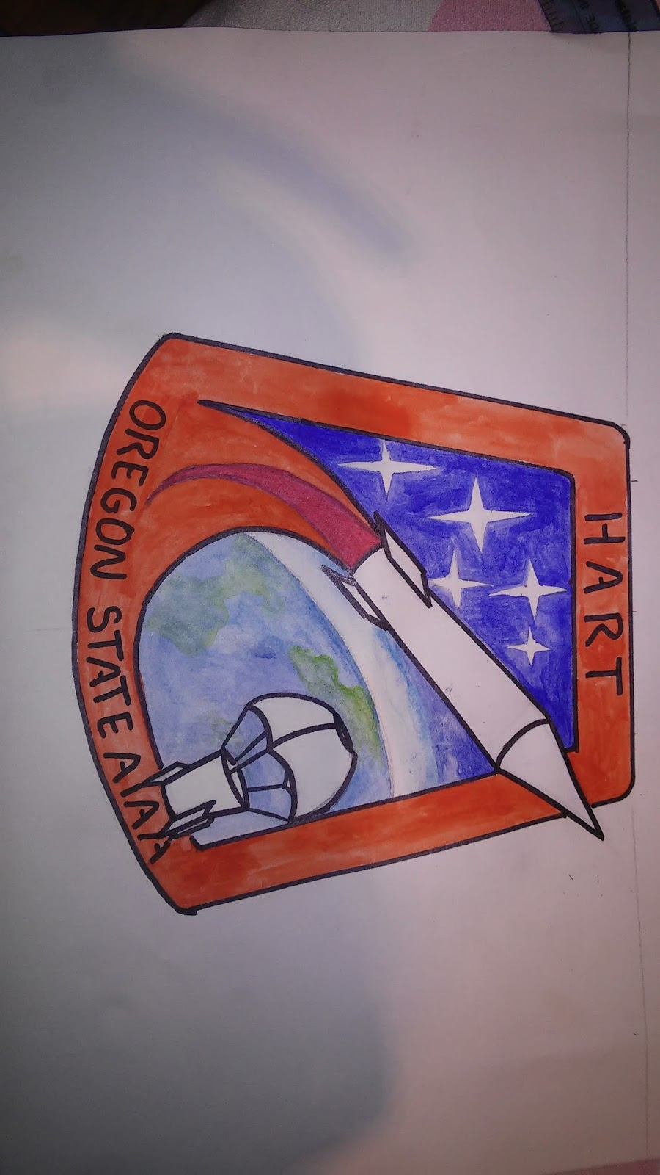
Plans
Create correctly scaled 3D environment
Testing suite
Telemetry Protocol
Avionics Team
Further Revision of Documents
OneNote
Design Document
Get data from launch
Test flight in March

